Slide 1
Second Step: Social emotional learning and prevention of aggressive behaviour
Žydrė Arlauskaitė
Children Support Centre,
Vilnius, Lithuania

Slide 2
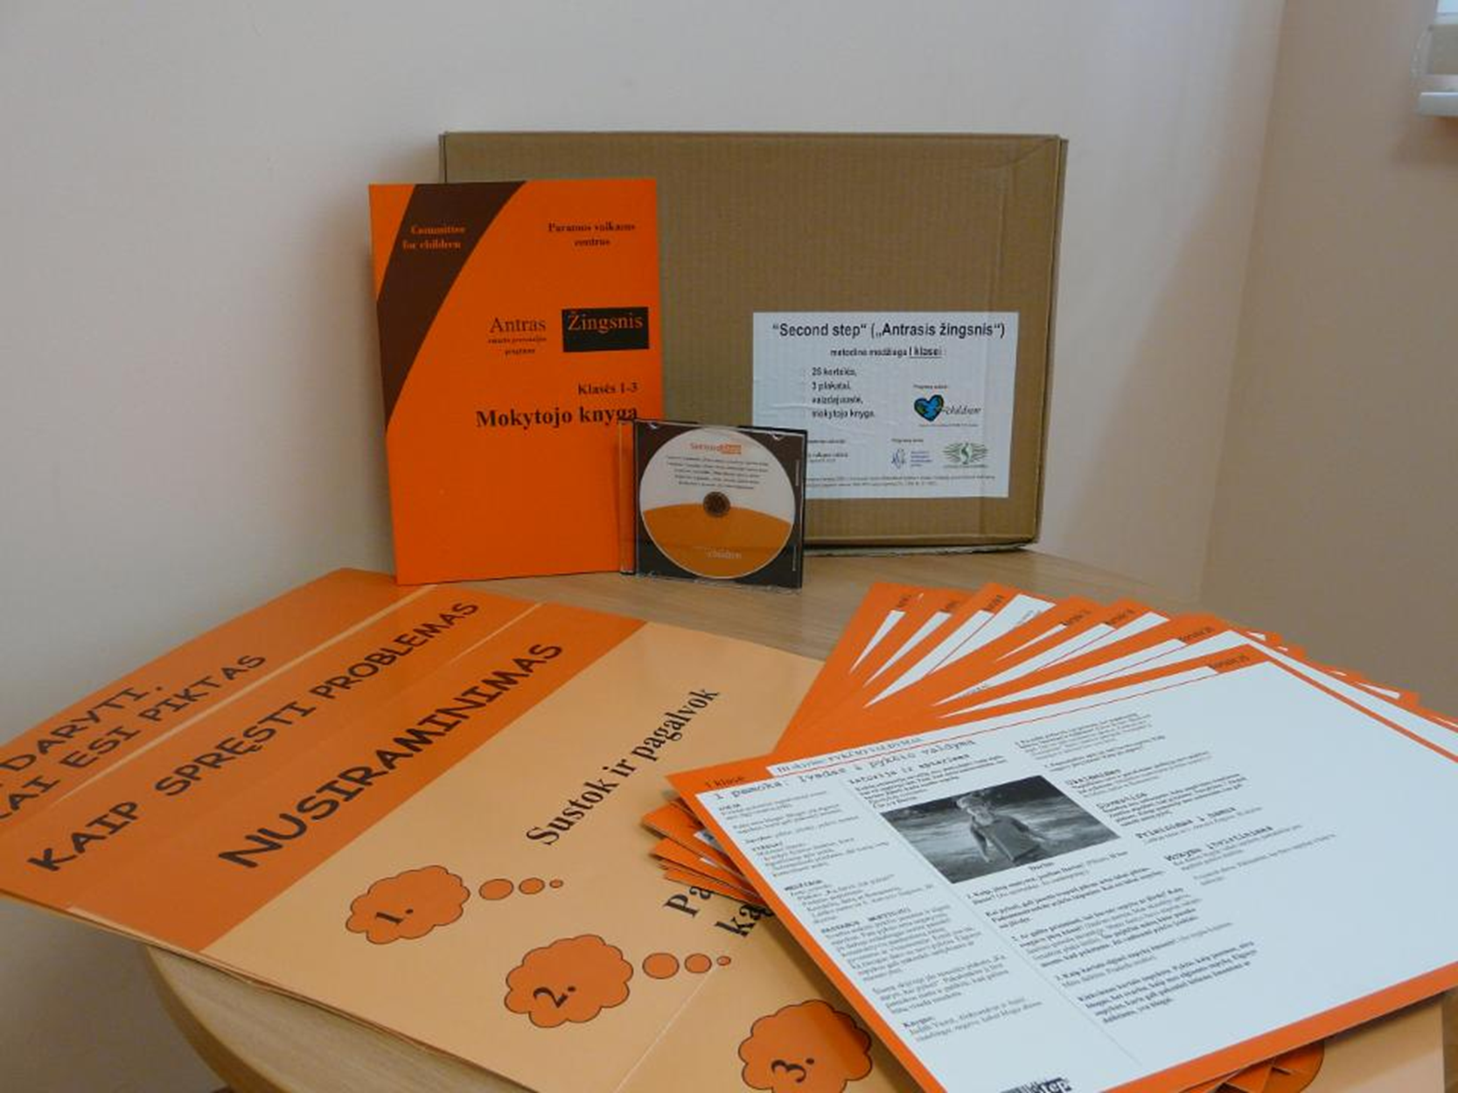

Slide 4
Second step
ANTRAS ŽINGSNIS – skills,
- prevention,
- job satisfaction.

Slide 5
Success in life when children:
Have realistic understanding about self esteem and ourselves.
Are able to control emotions and behaviour.
Are able to solve interpersonal conflicts effectively.
Are able to find out good solutions in everyday life.

Slide 6
1. Social emotional skills
Understanding and development of personal emotional skills.
Ability to raise positive goals and ability to work out for them.
Ability to take care and comfort others.

Slide 7
2. Social emotional skills
Raising positive relationship with others and ability to keep them.
Adequate management of situations in interpersonal relation.
Ability to solve problems with responsibility.

Slide 8
Children
Don’t have social emotional skills.
Look for safe, stabile adults(able to keep borders).
Live in unstable society with no clear rules and values.
Are curious, active, able to integrate new skills easily.
Will use skills for the rest of their life.

Slide 9
Parents
Don’t have time.
Don’t understand their own and teachers‘ responsibilities.
Don’t have special knowledge.
Are lost, angry and sad.

Slide 10
Teachers
Don’t know how to deal with active and angry children and their parents.
Don’t have special knowledge and clear methodology.
Are tired from tasks and permanent emotional stress.
Are lost, angry and sad.

Slide 11
History
1999 information about programme from Danish colleagues.
2004 were trained 2 first trainers for trainers.
2005 pilot agreement was made.
2005 started programme in 8 Vilnius schools.
2007 signed final agreement with Committee for Children.
2007 research of programme effectiveness started in Vilnius.
2008 Second step was included to the group of the National prevention programmes in Lithuania.
Today - schools are aware and looking for Second Step

Slide 12
Goals
To raise awareness about destructive behaviour impact for the child's future success.
To implement effective strategies of early prevention and intervention.
To promote non-violent attitudes and behaviour towards and among children.
To promote importance of social – emotional learning in whole school community.
To develop practical skills of professionals: teachers and psychologists.
To develop child's social – emotional skills.
To empower school community to deal with child destructive behaviour problems by using simple tool

Slide 13
Second step training
Participants: primary school teachers.
Task: to implement destructive behaviour prevention curriculum in primary school.
Training:24 hours

Slide 14
Second step training key issues
To examine and change teachers attitudes towards destructive behaviour;
to give tool how to teach children of empathy, anger management, impulse control and how to solve problems in social acceptable ways;
to bring understanding about positive role model effect.

Slide 15
Second step
1st grade
30-35 minutes per lesson, 22 lessons
2nd grade
30-35 minutes per lesson, 17 lessons
3rd grade
30-35 minutes per lesson, 15 lessons
4th grade
30-35 minutes per lesson, 22 lessons

Slide 16
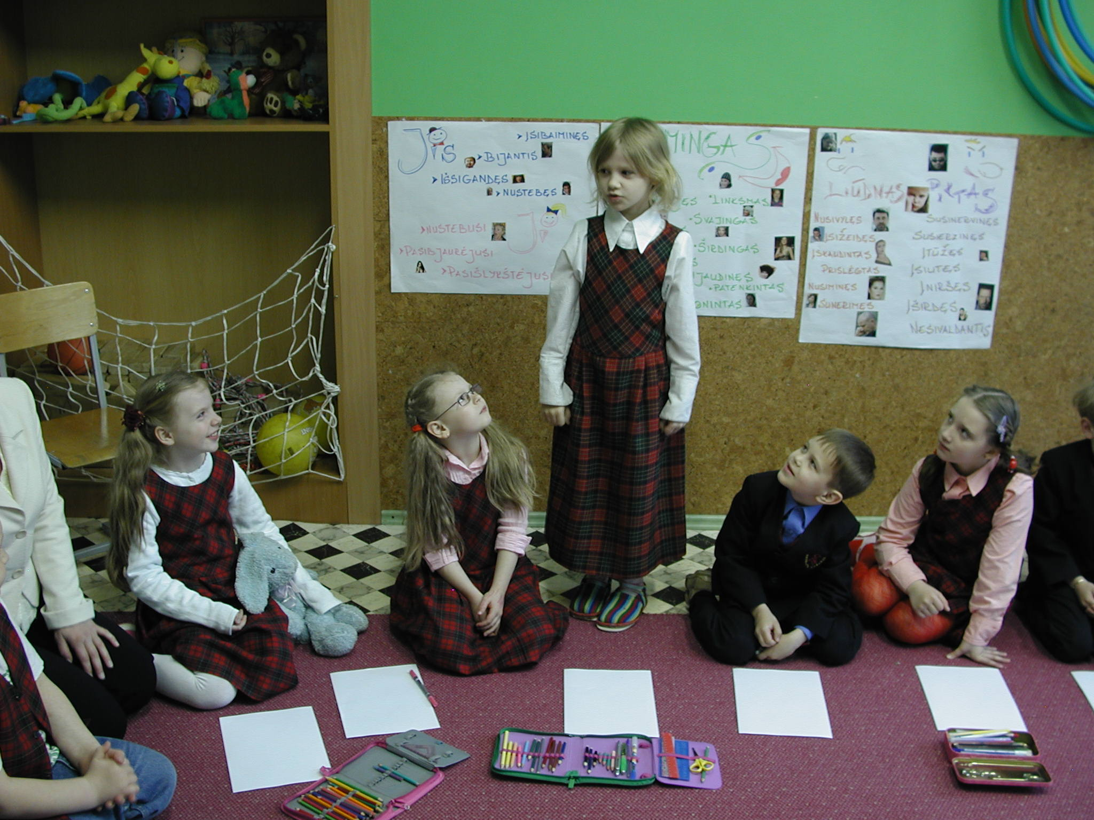

Slide 17
Second step – now in LT.
All country.
Different schools and classes.
Over 1670 trained teachers.
Over 432 schools – users.
Trained and under permanent supervision our 20 programme consultants.
Permanently supervised teachers- programme users.

Slide 18
Feedback
From teachers.
From parents.
From specialists.
From children.

Slide 19
What is good about SS?
Possible to start with one motivated person.
Will reach all child in class.
Very well structured, framed programme.
Sustainability during all primary school ( grades 1st -4th).
Very interesting for all participants: children and teachers.
Everybody will get skills: children, teachers, parents.

Slide 20
The End
Children Support Centre,
Vilnius, Lithuania,
pvc@pvc.lt;
antraszingsnis@pvc.lt;
zydre@pvc.lt

